Slide 1


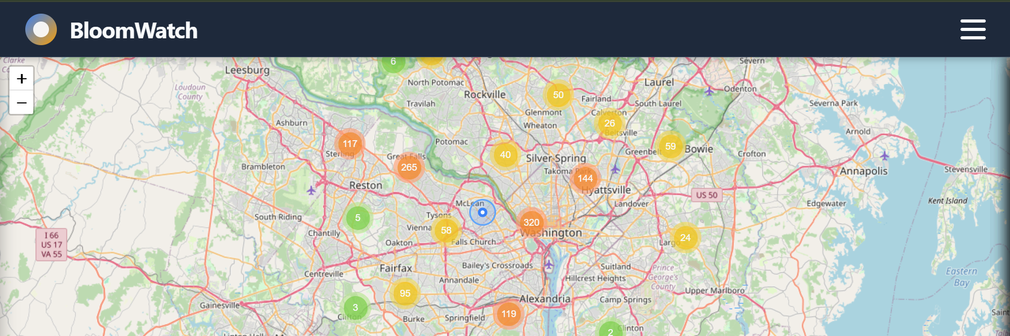

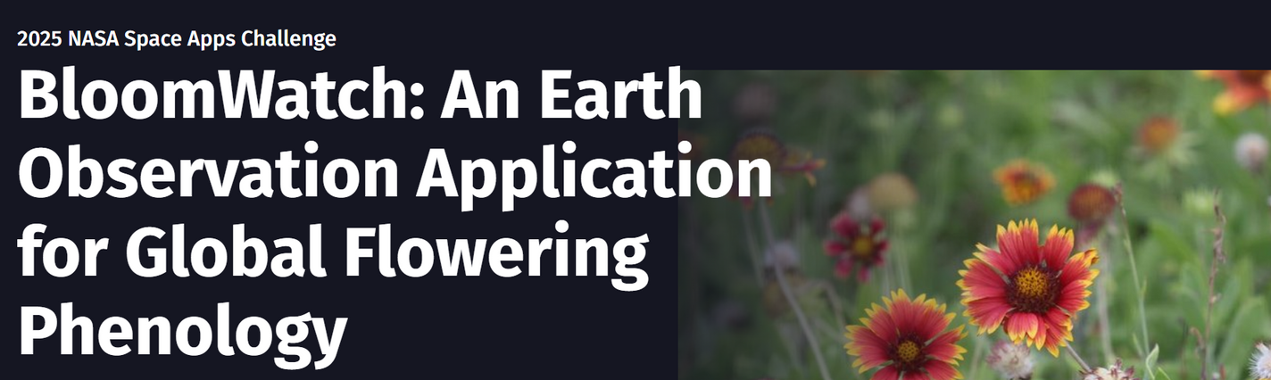
FLORACAST
Team：Wiedergabegerät
Tim Bolewski Peijie Wang
Kefei Tian Haoyang Zhou

Slide 2
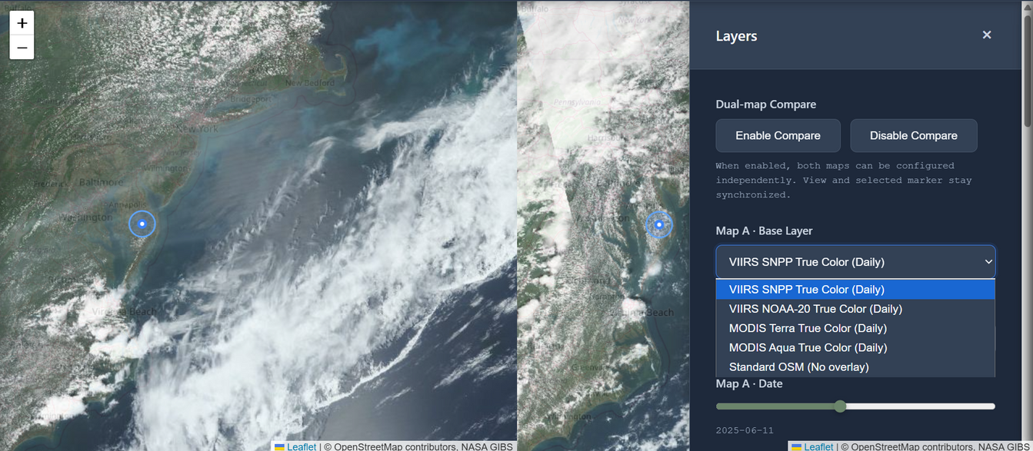
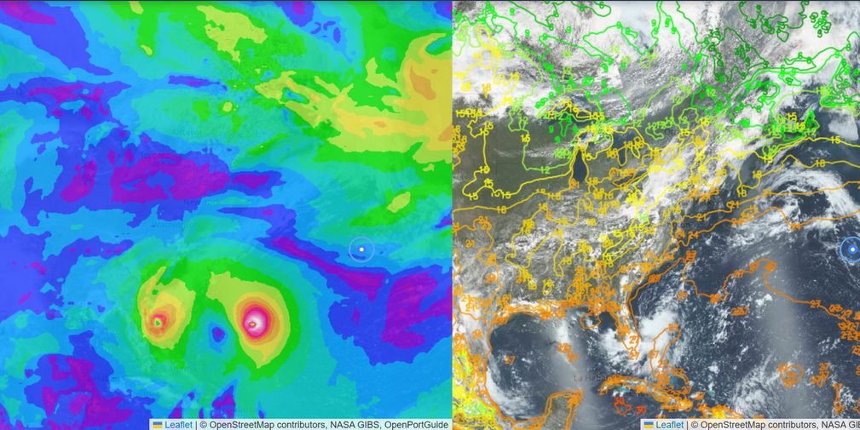
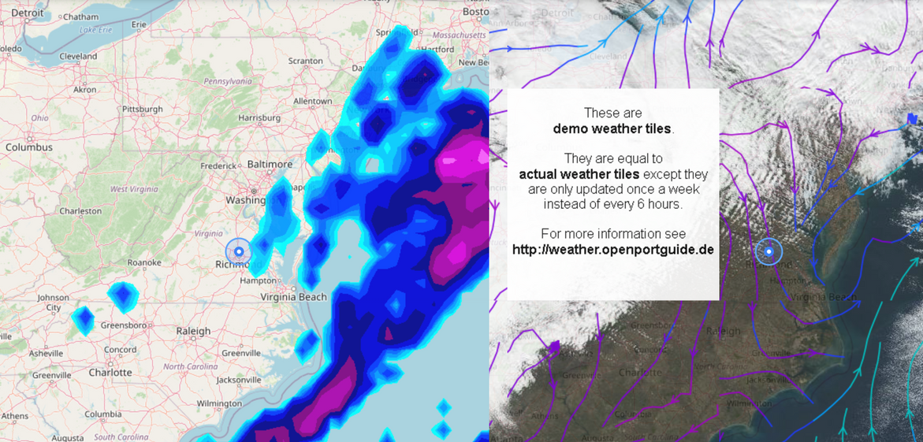
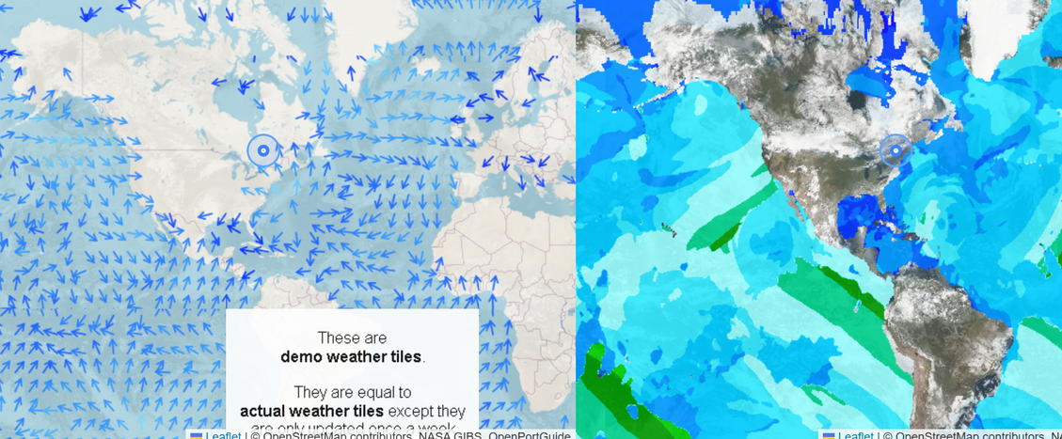
Selection of satellite maps
Dual-Map Comparison
You can choose from 22 different layers including satellite images, temperature maps, NDVI maps, etc. to observe or compare any location in the world.
gust vs. air temperature
primary wave height direction vs. primary wave period
precipitation vs. wind-stream

Slide 3
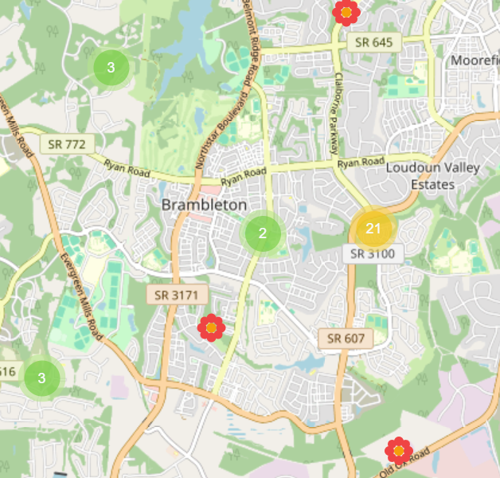
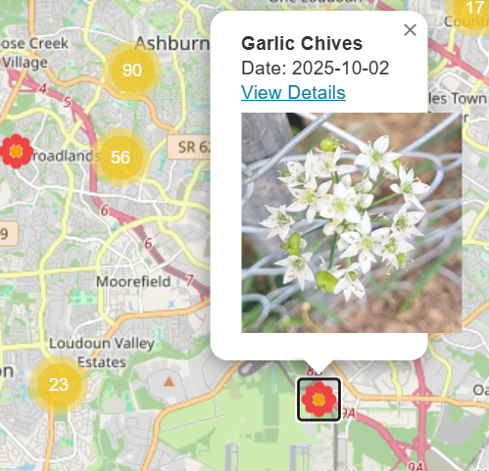
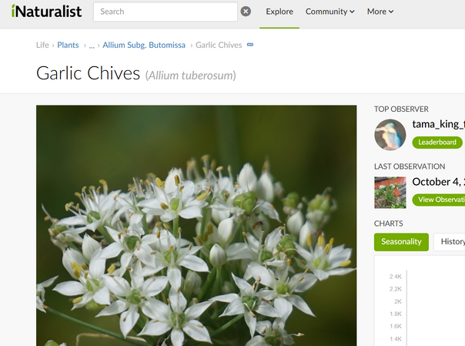
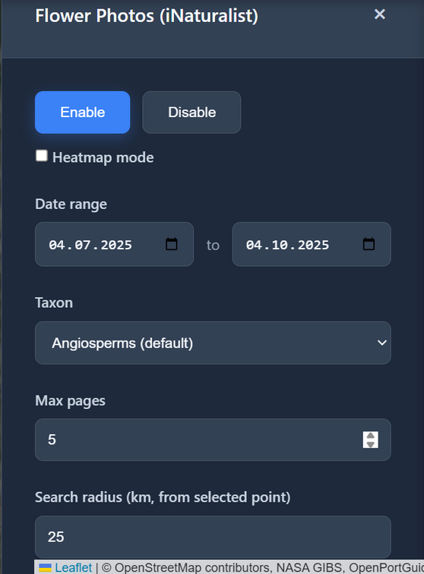
Flowers exploration
Detailed information collected from https://www.inaturalist.org/
You can observe photos of local real flowers and choose the observation time at will
Date range
the flowers’ locations

Slide 4
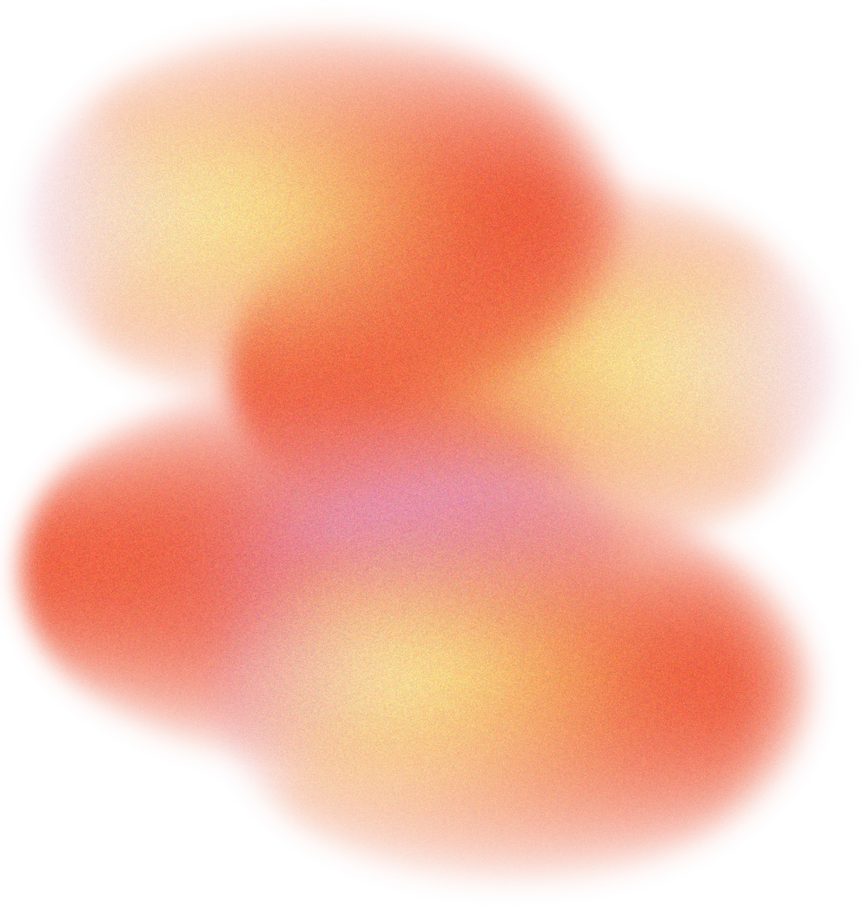
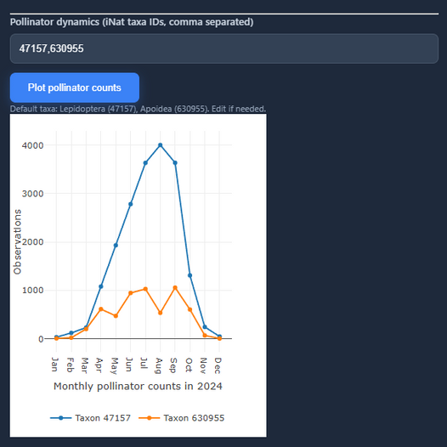
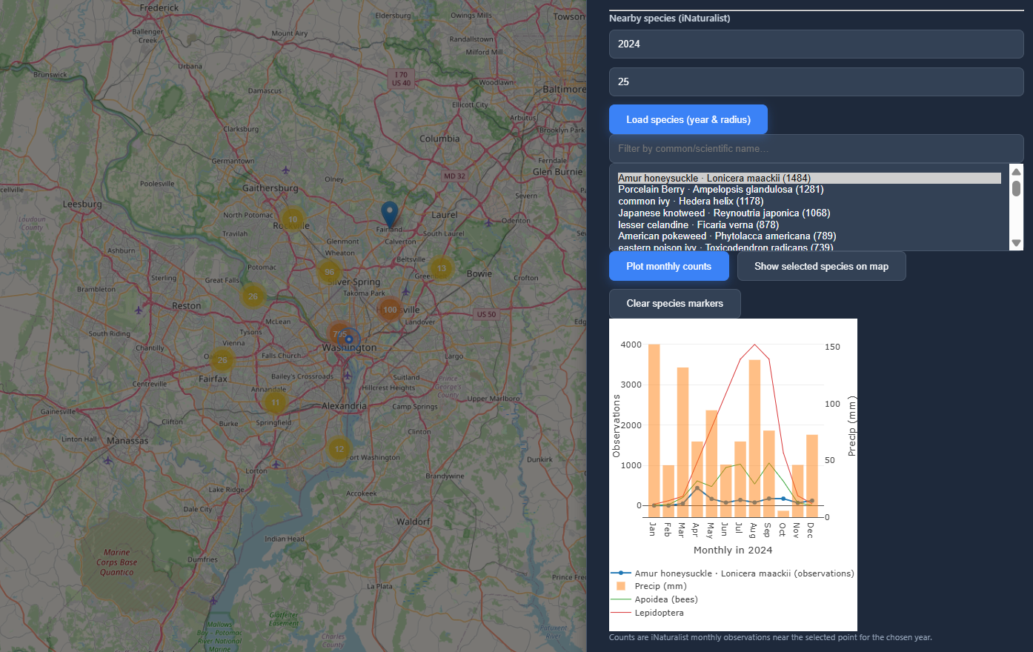
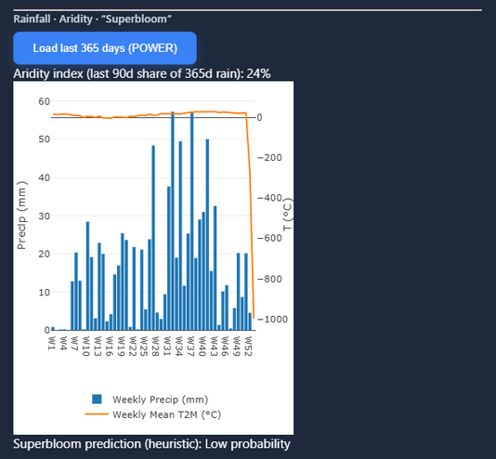
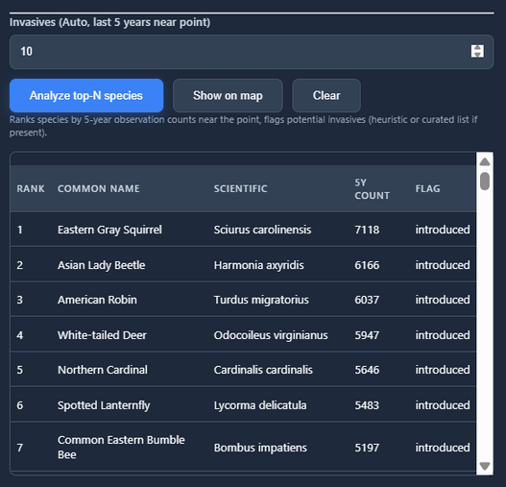
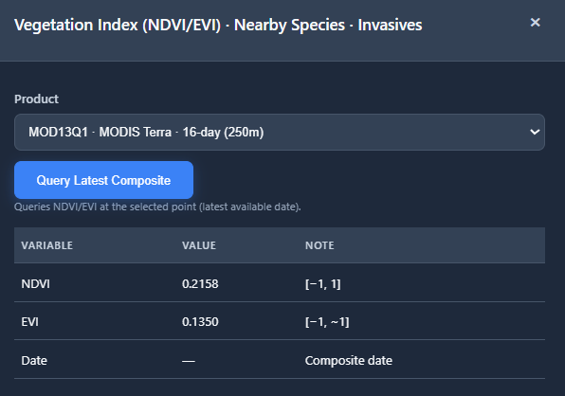
Vegetation Index
Rainfall · Aridity · “Superbloom”
Pollinator dynamics
Nearby species
Invasives
NDVI/EVI

Slide 5
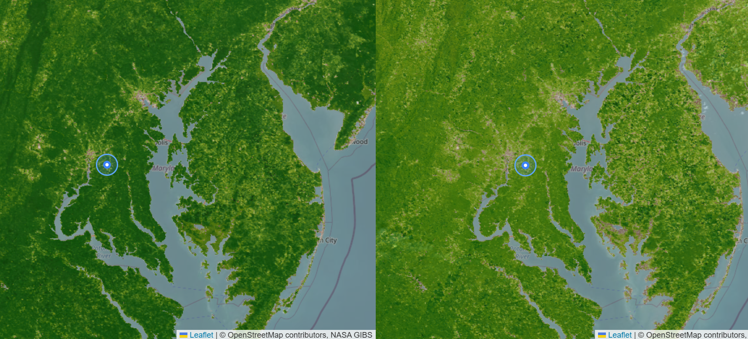
Vegetation Index (NDVI/EVI)
NDVI: Normalized Difference Vegetation Index
EVI: Enhanced Vegetation Index
NDVI/EVI: presents the state and vitality of vegetation
visualization--NASA GIBS(WMS) overlay
settings: VIIRS SNPP NDVI 8Days
VIIRS SNPP EVI8Days

Slide 6
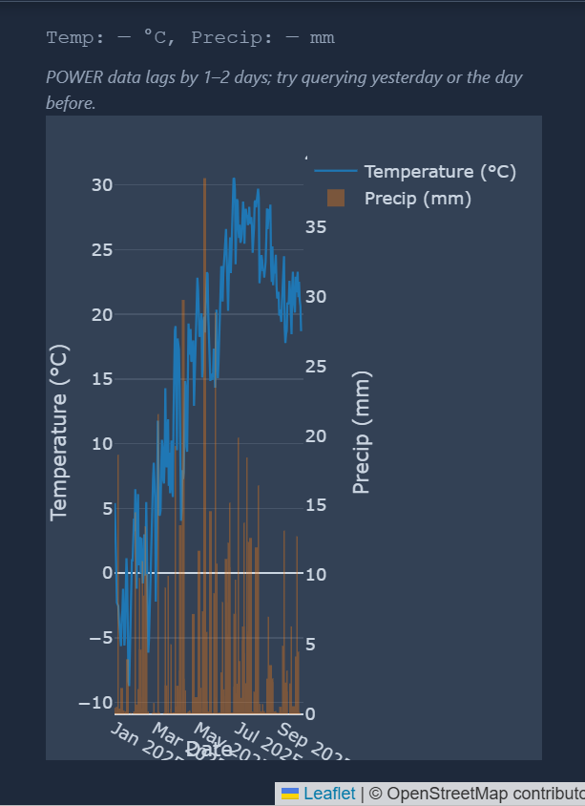
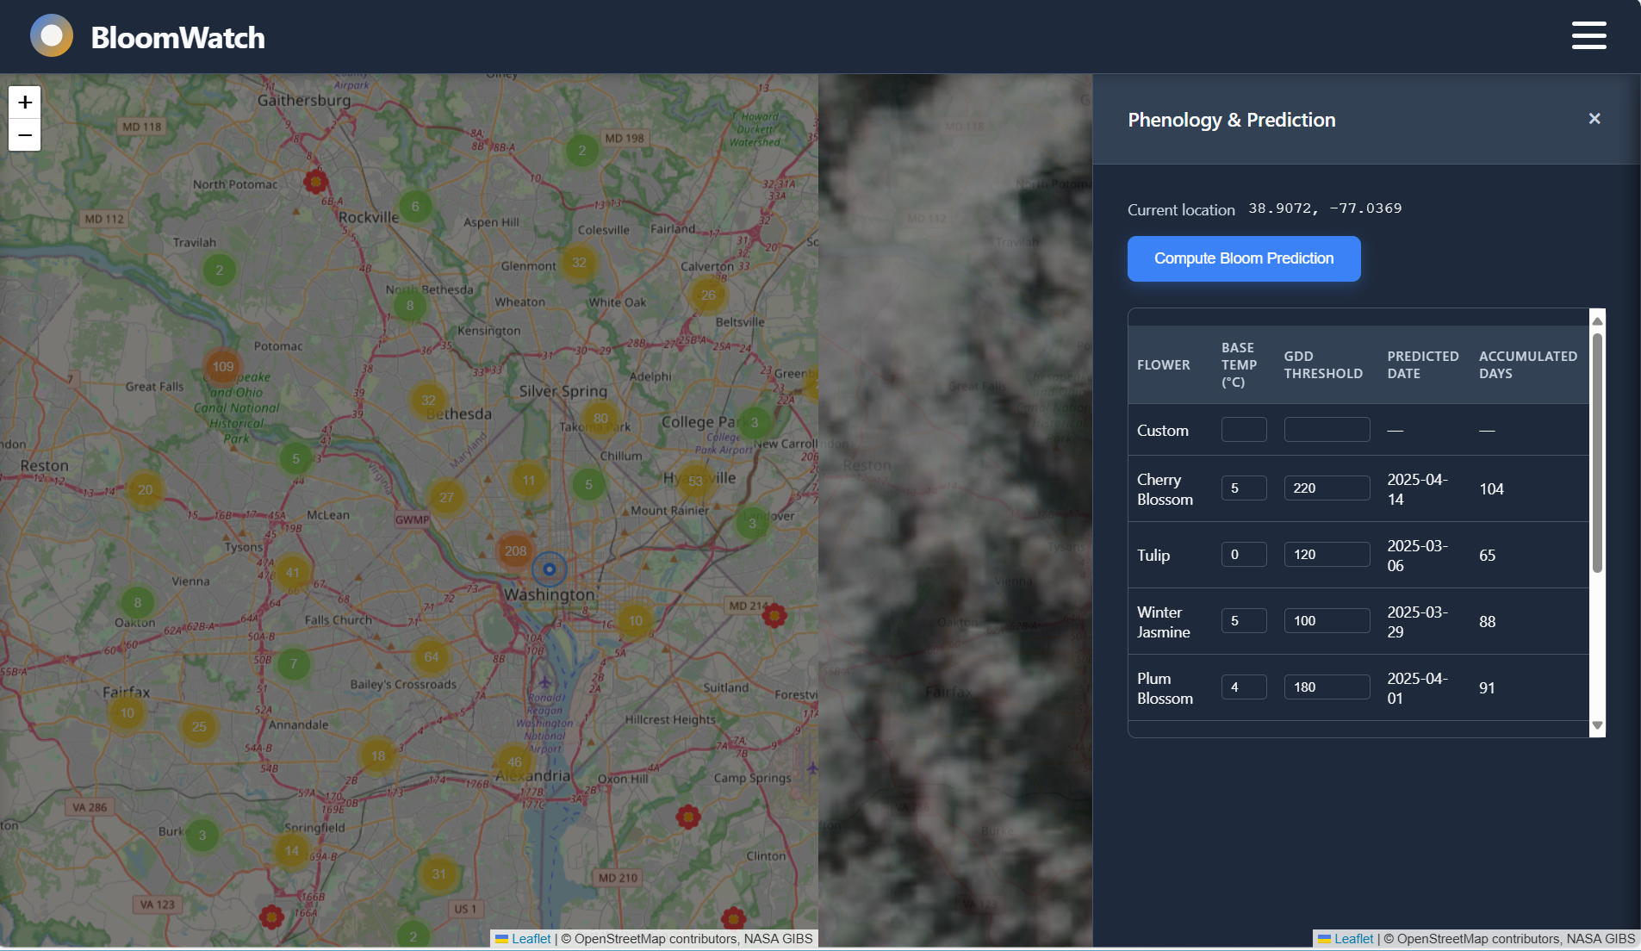
Phenology & Prediction
Weather detection
Query date:
03.Oct
GDD : Growing Degree Days
different flowers and predicted dates
Automatically calculate local flowering time and flowering period through Base Temp and GDD
enables applications in agriculture, tourism, and horticulture

Slide 7
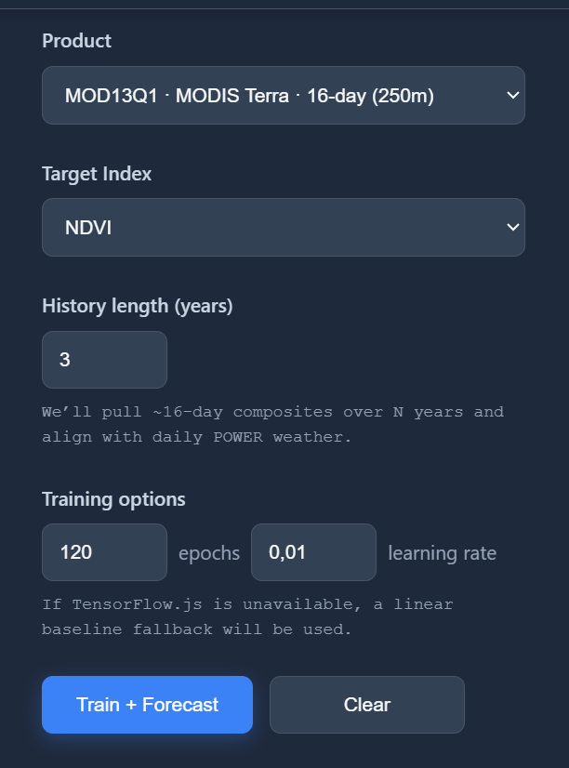
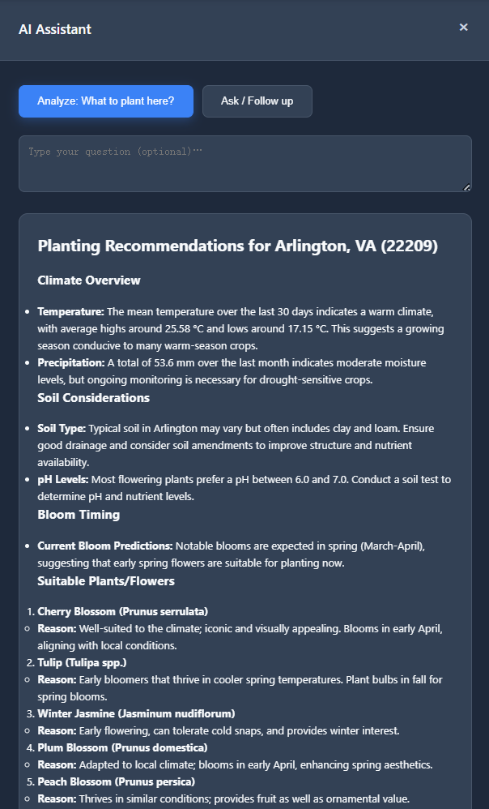
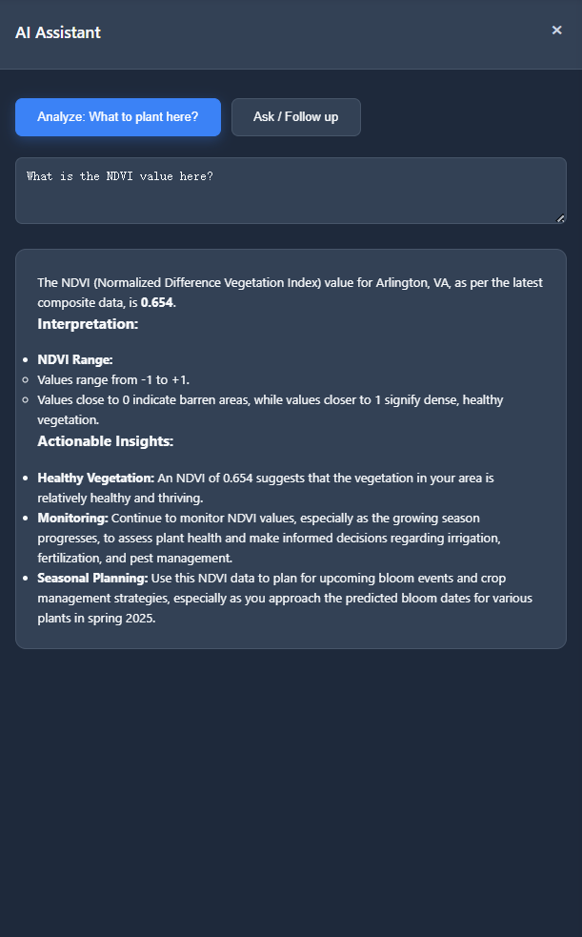
AI Assistant
Machine learning Forecast
usage of the ChatGPT model
Ask for an analysis of the blooming state
to inform planting strategies
Predicting future NDVI values

